Slide 1
COMPREHENSIVE DIGITAL MARKETING FOR TECH MAHINDRA

Slide 2
Presented by:
Team leader: D Aishwarya
Team no.1 : G.K Bala subramanyam
Team no.2. : G.N Mahesh
Team no.3. : G Ramurthy
Team no. 4. : Golla Dileep

Slide 3
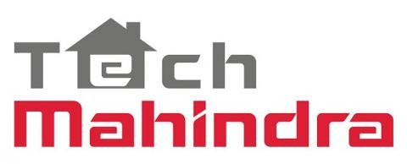
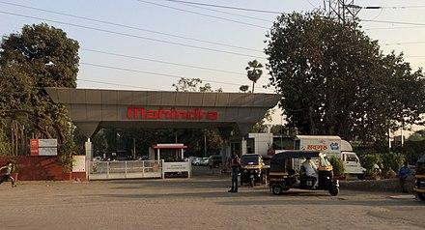
BRAND STUDY:
Tech Mahindra represents the connected world, offering innovative and customer-centric information technology services and solutions, enabling Enterprises, Associates, and Society to Rise.
Mahindra & Mahindra was founded as a steel trading company on October 2, 1945, in Ludhiana as Mahindra & Mohammed by brothers Kailash Chandra Mahindra and Jagdish Chandra Mahindra, along with Malik Ghulam Muhammad. Anand Mahindra, the present Chairman of Mahindra Group, is the grandson of Jagdish Chandra Mahindra. In 1948, the company changed its name to Mahindra & Mahindra. Tech Mahindra is one of the top Big Tech (India) companies. Tech Mahindra has 1,262 active clients as of June 2022.

Slide 4
It is headquartered at Pune, Maharashtra, India. Tech Mahindra was ranked #5 in India's software services (IT) firms and overall #111 in Fortune India 500 list for 2012. Tech Mahindra, on 25 June 2013, announced the completion of a merger with Mahindra Satyam. The company is headquartered in Pune and has its registered office in Mumbai.
The C.P Gurnani was the first CEO and managing director of the tec Mahindra . And the present now Mohit Joshi is Managing Director and Chief Executive Officer designate of Tech Mahindra – a USD 6.5+ billion digital transformation, consulting and business reengineering services and solutions provider with 148,000+ employees across 90 countries.

Slide 5
PRODUCT GOALS
Tech Mahindra creates aesthetic customer engaging products, smart devices and direct to customer equipment that provides insight into consumer’s mind, driven by Technologies like IoT, AR, VR, MR, Artificial Intelligence and Computer vision. Our solutions around Products, Devices & Equipment that come in direct contact with the End-Consumer.
KPI GOALS
Smart IOT Devices
Understanding Consumer Preferences and Behaviour using smart, custom designed IOT devices authentication of genuine products
Smart D2C Equipment
Serving consumers anytime anywhere using smart intuitive & interactive direct to consumer (D2C) equipments.

Slide 6
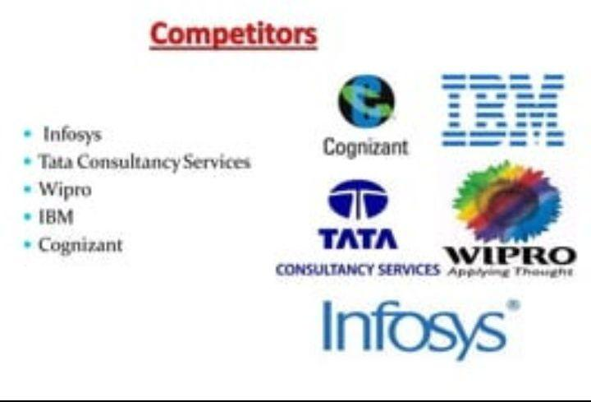
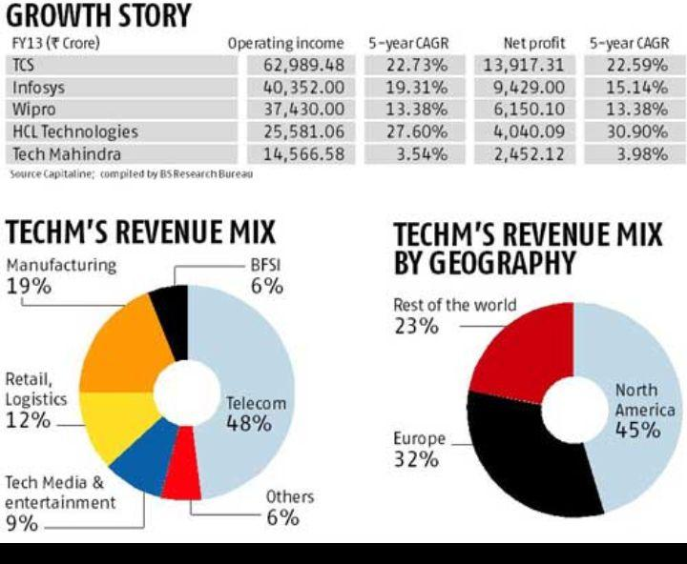
COMPETITORS

Slide 7
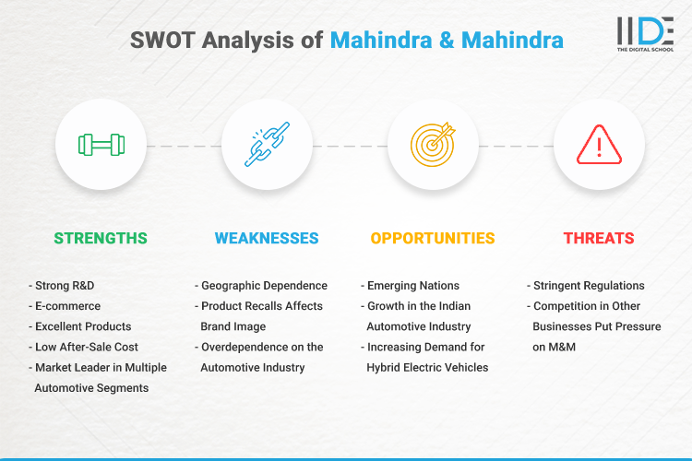
SWOT ANALYSIS:

Slide 8
NEW MARKETING STRATEGY:
The strategy focuses on three megatrends, four tech bets, and three outcomes for our customers. 3-4-3 is our strategy and TechMNxT is our transformation approach to deliver it. This strategy is implemented across all the industries that we operate in.
in addition to its CSR portfolio fulfilled through the Foundation, Tech Mahindra also has a well-defined charter on Individual Social Responsibility (ISR). In a Forbes blog, CEO CP Gurnani calls ISR,
“ an emotional investment that can last a lifetime & beyond, and transform communities for a sustainable future.”

Slide 9
TOOLS
Smart Monitoring And Resolution Tool (SMART)
Faster, Smarter Services Management and Monitoring with SMART Observability Powered by AWS Cloud.
Most enterprises today are adopting or starting to adopt cloud and microservices for hosting and running their applications. The advent of containers, serverless compute, infra as code have made software development cheaper, flexible, scalable, and agile ever so better than before. However, it has also increased the complexity for the developers to pin-point an issue or troubleshoot errors. Our SMART (smart monitoring and resolution tool) Observability solution focuses on providing a single pane of glass view into the system of systems running the applications. It integrates logs, metrics, and traces in an intuitive, user friendly dashboard for a wide range of users leveraging existing observability tools and software stacks.

Slide 10
SUGGESTIONS:
"Tech Mahindra has an overall rating of 3.6 out of 5, based on over 33,121 reviews left anonymously by employees. 66% of employees would recommend working at Tech Mahindra to a friend and 64% have a positive outlook for the business. This rating has been stable over the past 12 months."

Slide 11
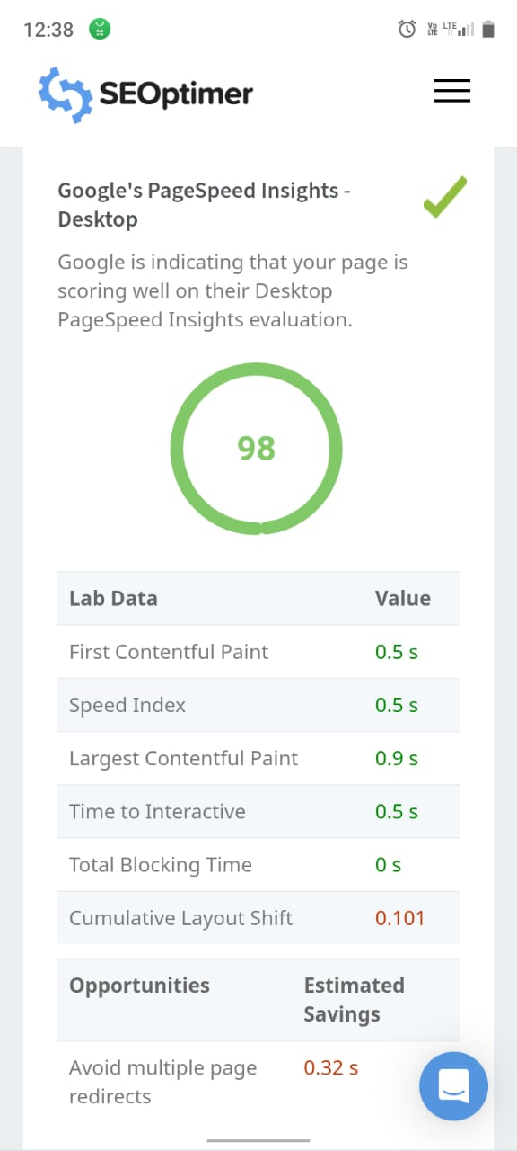
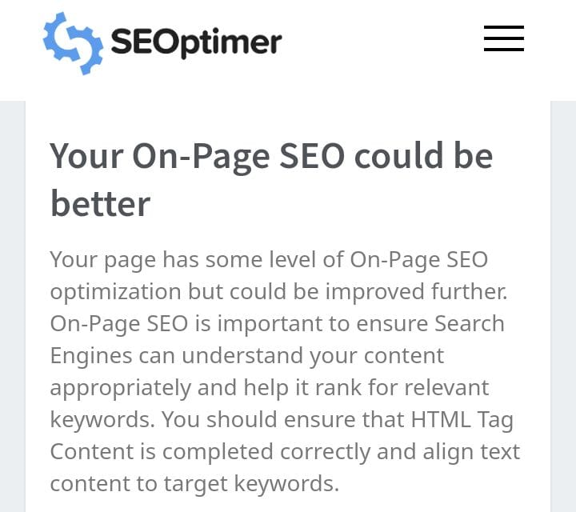
SEO AND KEYWORD RESEARCH

Slide 12
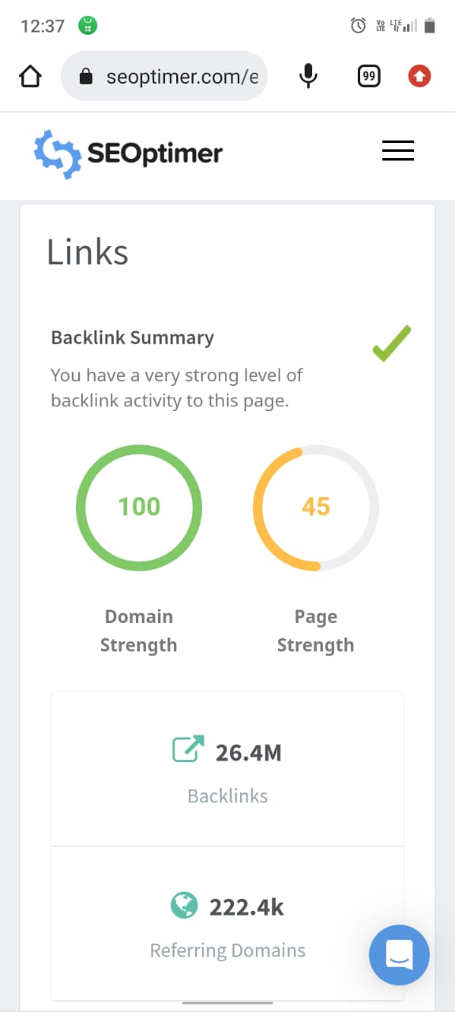
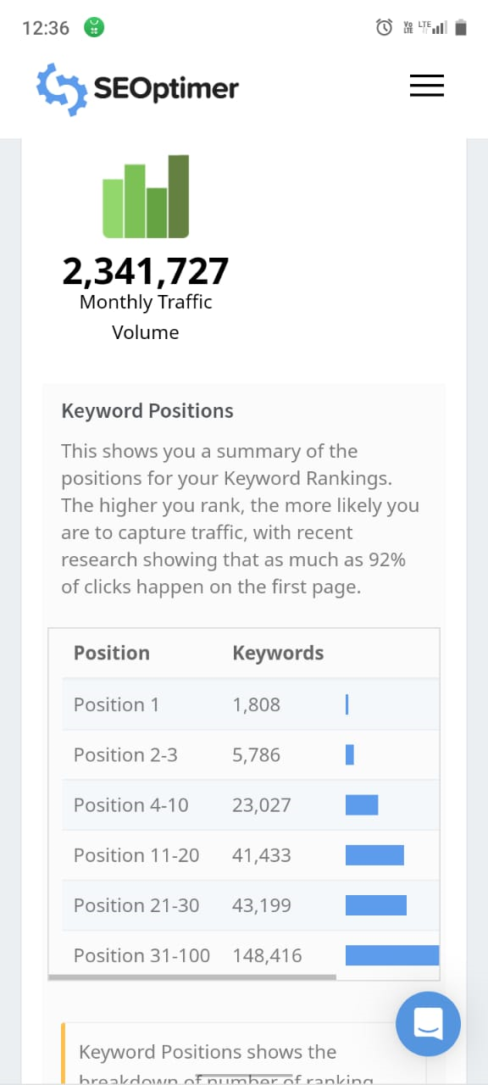
SEO AND KEYWORD RESEARCH

Slide 13
